Slide 1

Introductory Presentation for
CS399 Seminar
Rethinking the Truly Unsupervised Image-to-Image Translation
- Tarusi Mittal
1901CS65

Slide 2
Overview
Truly unsupervised image to image translation
No input-output pair or domain label annotation required
Solves 3 problems
Identifying domain characteristics of images
Encode content and style of an input image
Learn a mapping function from one domain to another

Slide 3
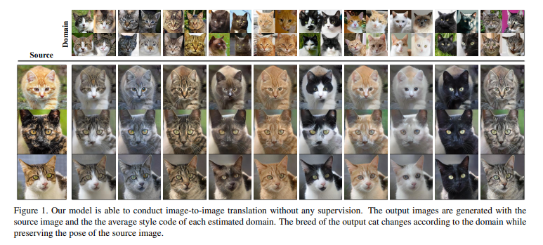
Introduction

Slide 4
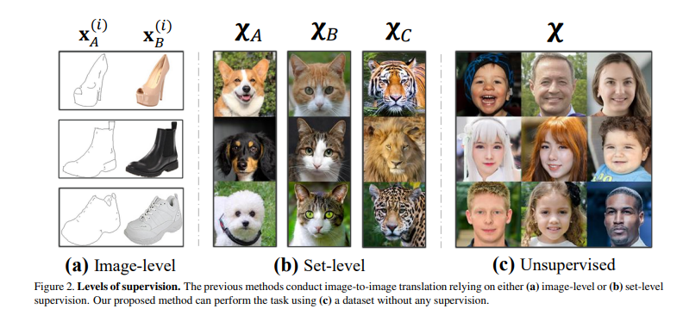
Stages of Image to Image Translation

Slide 5
Previous Works
Image-to-image translation: The seminal work of Pix2Pix image-to-image translation models have shown impressive results. Exploiting the cycle consistency constraint or shared latent space assumption, these methods were able to train the model with a set-level supervision (domains) solely. However, acquiring domain information can be a huge burden in practical applications where a large amount of data are gathered from several mixed domains, e.g., web images. Not only does this complicates the data collection, but it restricts the methods only applicable to the existing dataset and domains.Inspired from few shot learning, the paper proposed FUNIT that works on previously unseen target classes. However, FUNIT still requires the labels for training. Wang et al. utilized the noise tolerant pseudo labeling scheme to reduce the label cost at the training process. Recently, Bahng et al partially addressed this by adopting the ImageNet pre-trained classifier for extracting domain information

Slide 6
Previous Works
Unsupervised representation learning and clustering: Unsupervised representation learning aims to extract meaningful features for downstream tasks without any human supervision. To this end, many researchers have proposed to utilize the information that can be acquired from the data itself. Recently, by incorporating contrastive learning into a dictionary learning framework, MoCo achieved outstanding performance in various downstream tasks under reasonable mini-batch size. On the other hand, IIC utilized the mutual information maximization in an unsupervised manner so that the network, clusters the images while assigning the images evenly. Though IIC provided a principled way to perform unsupervised clustering, the method fails to scale up when combined with a difficult downstream task such as image-to image translation.
By taking the best of both worlds, we aim to solve unsupervised image-to-image translation.

Slide 7
What is special about our approach
First of all, it significantly reduces the effort of data annotation for model training.
As a natural byproduct, the unsupervised model can be robust against the noisy labels produced by the manual labeling process. To tackle this problem, we design our model having three sub-modules:
Clustering the images by approximating the set-level characteristics
encoding the individual content and style of an input image
Learning a mapping function among the estimated domains
TUNIT is insensitive to the hyperparameter (i.e. the number of clusters) and serves as a strong baseline for the semi-supervised setting

Slide 8
Architecture
How do they do this?
They have 3 different parts to this model
Encoder - Guiding network
Discriminator
Generator

Slide 9
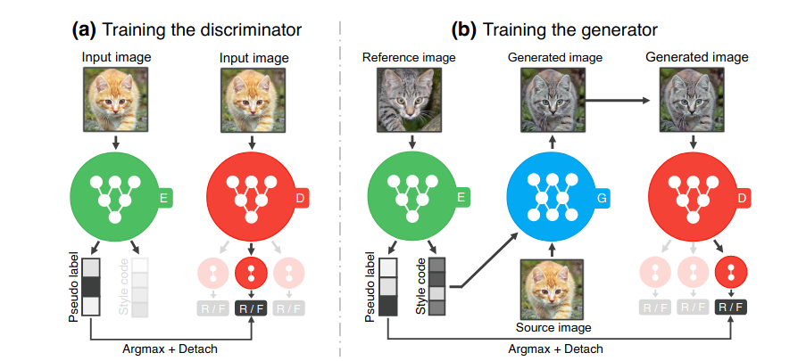
Architectural Structure

Slide 10
Learning to produce domain labels and encode style features
Pseudo Label : To represent classes, denoted by an integer value. As seen it is argmax and detached that is there is no gradient backpropagation along it.
Style Code: Describes all the images from same label of the reference image.

Slide 11
Maximizing Mutual Information
We maximize the mutual information (MI) between the domain assignments of an image x and those of its randomly augmented version x + (e.g. random cropping, horizontal flip)
X -> X1, X2, X3 …….
It lets all samples distribute evenly across all domains.

Slide 12

Loss Function
The discriminator requires a target domain label to provide useful gradients to the generator for translating an image into the target domain. Therefore, we adopt the differentiable clustering technique that maximizes the mutual information (MI) between an image x and its randomly augmented version x +.

Slide 13

Style Loss Function
The following loss function is used to train the encoder w.r.t style
It basically guarantees that we have a unique style for each image. This style is basically indvidual and it does not care about the domain.
We observe that adding this objective significantly improves unsupervised classification accuracy on AnimalFaces from 50.6% to 84.1% compared to the previous overclustering approach
X+ S+
X1 S
X2 S2
X3 S3
S-

Slide 14



Loss Functions
Adversarial Loss:
Style Contrastive Loss:
Image Reconstruction Loss:

Slide 15

Overall Loss Function

Slide 16
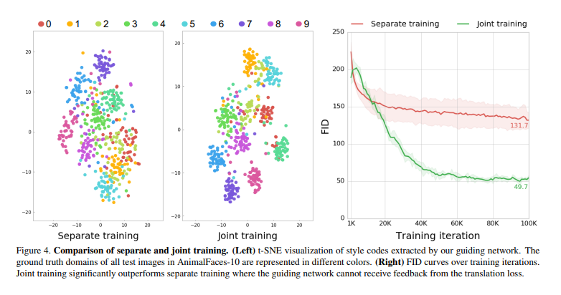
Comparison

Slide 17
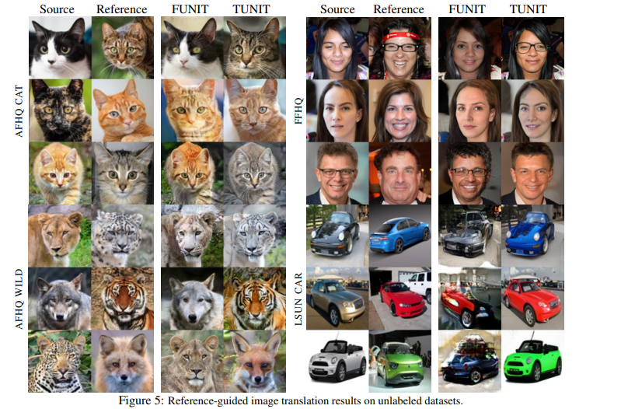
Comparison
We evaluate TUNIT on the unlabeled datasets (AFHQ, FFHQ and LSUN-Car), having no clear separations of the domains. For AFHQ, we train three individual models for dog, cat and wild. For all experiments, we use FUNIT as a baseline, where all the labels for training are regarded the same as one. We set the number of clusters Kˆ =10 for all the TUNIT models We observe that the results of TUNIT adequately reflect the style feature of the references such as the textures of cats or cars and the species of the wilds. Although FFHQ has no clear domain distinctions, TUNIT captures the existence of glasses or smile as domains, and then add or remove glasses or smile. However, FUNIT performs much worse than TUNIT in this truly unsupervised scenario

Slide 18
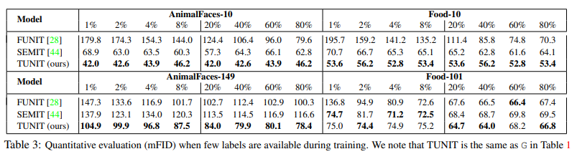
Comparison
We build TUNIT by introducing the guiding network and the new objective functions. The changes significantly improve the accuracy on both datasets, particularly achieving similar mFID of the improved set-level supervised model B. Our final model, G matches or outperforms mFID and D&C of B

Slide 19
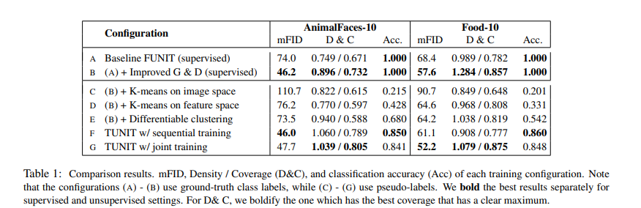
Comparison
To provide a general sense of image quality, we use the mean of class-wise Frenchet Inception Distance (mFID). It can avoid the degenerate case of the original FID, which assigns a good score when the model conveying the source image as is. A lower mFID score means better image quality, and D&C scores that are bigger or closer to 1.0 indicate better fidelity and diversity, respectively.
Table 1 summarizes the effect of each component of TUNIT and rigorous comparisons with the state-of-the-art supervised method, FUNIT

Slide 20
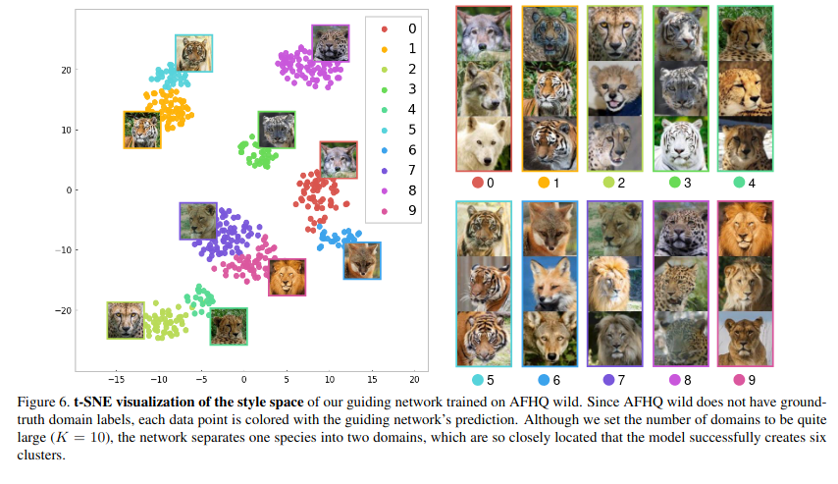
Examples:

Slide 21
Summary
Unsupervised image to image translation should not utilize any supervision
Proposes truly unsupervised image to image translation
Guidance network performs unsupervised representation learning

Slide 22


